Slide 1

Current Technologies

Slide 2
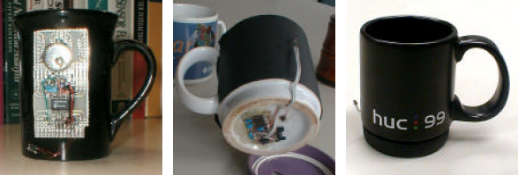
Media Cup
Coffee Cup → Represent the context information: Location, Temperature
Components
Acceleration sensor
Microcontroller
Infrared diode
Lithium Battery
Semiconductor chip
Overhead Transceiver
Fig.1. Media cup Prototypes
Hans-W. Gellersen et al. The MediaCup: Awareness Technology embedded in an Everyday Object in Telecooperation office, Karlsruhe, Germany, 2001
Notes:
first version→ for initial data collection but was not fit for day-to-day use.
second prototype→ embedded the MediaCup hardware at the bottom of a coffee cup.
third prototype → the hardware mounted in the rubber base of the HUC99 coffee cup, allowing removal so that the cup can be dishwashed.

Slide 3
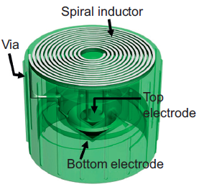
Smart Cap
Sensing the quality of liquid in fluidic package
Based on changes in capacitance
Resonance frequency shifts of the LC tank via an inductive reader
LC tank as wireless-resonant sensor
Passive operation without power consumption
Fig.2. Design of a wireless “smart cap”
Sung-Yueh Wu et al. 3D-printed microelectronics for integrated circuitry and passive wireless sensors in Microsystems & Nanoengineering, USA,2015

Slide 4
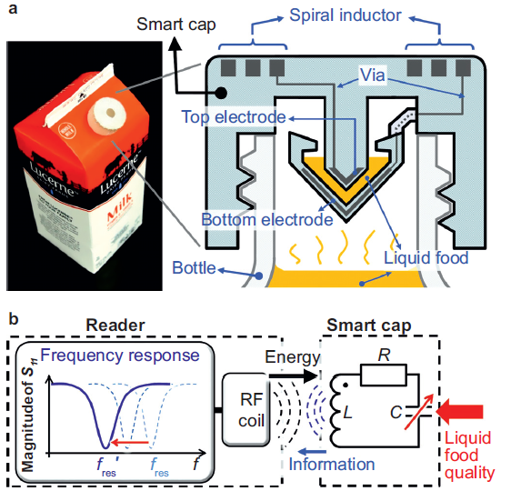
Smart Cap (Design)
LC resonant circuit
Fig.3. (a) smart cap with milk package, (b) LC circuit diagram
Notes:
By flipping the food package upside down. the liquid food is trapped inside the capacitor gap of the LC tank and acts as the dielectric
material. The LC tank’s fres, is determined by the dielectric constant of the liquid food.

Slide 5
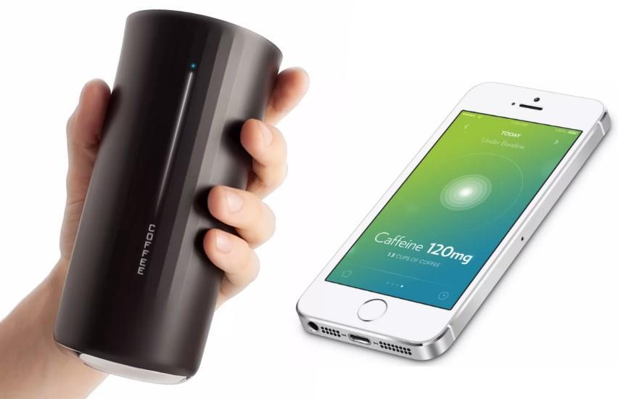
Vessyl
Smart Cup → amount of liquid, type of beverage
Information on the side
Mobile app track every sip
Turns blue → Hydration
Only track water
Fig.4. Vessyl smart cup
http://hiconsumption.com/2014/06/vessyl-smart-cup/

Slide 6
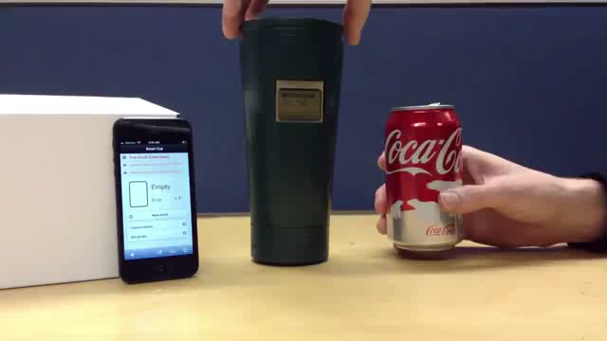
Berkeley
Smart cup → track the consumption of common beverages
LED on one side with sensor on the other side
Force resistor on the bottom of the cup
Wireless device in the base
App in mobile device

Slide 7
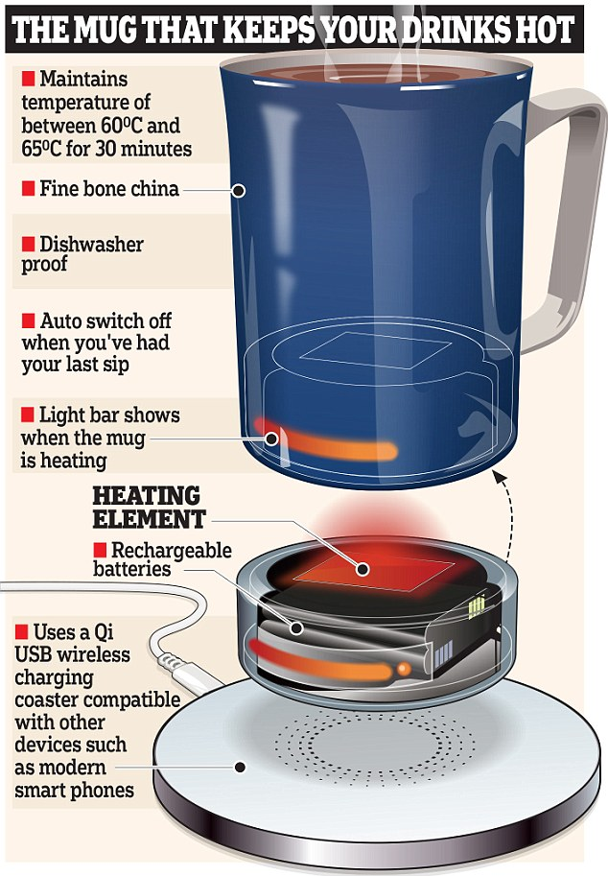
Glowstone
Smart mug → the perfect temperature
Material: fine bone china
Wireless charging
Dishwasher Safe
Automatic switch off
Mug’s base remains cool while
keeping the liquid hot
Glowstone app
Fig.5. Glowstone smart mug
http://www.dailymail.co.uk

Slide 8
References
Hans-W. Gellersen et al. The MediaCup: Awareness Technology embedded in an Everyday Object in Telecooperation office, Karlsruhe, Germany, 2001
Sung-Yueh Wu et al. 3D-printed microelectronics for integrated circuitry and passive wireless sensors in Microsystems & Nanoengineering, USA,2015
https://www.entrepreneur.com/article/234653
https://www.ischool.berkeley.edu
https://www.glowstone.tech/the-mug/

Slide 9
Thank you for your attention! Any questions?

